Slide 1

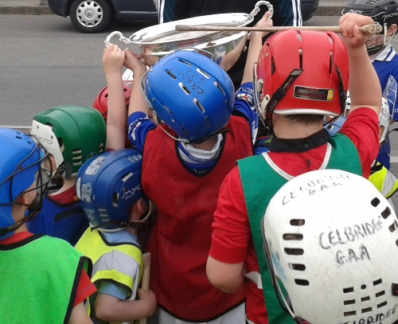
GAA Club Nursery

Slide 2
Gaa Nursery – Aims
To encourage Children to participate in playing football, hurling and Camogie in a structured and fun environment by:
Introducing the child to the skills of hurling, camogie and football
Preparing the child to participate at competitive or recreational level as a player
Producing players who have a basic command of all fundamental playing skills.
Developing Agility, Balance, Co-ordination and footwork of the players
Make new friends along the way
The emphasis of the Club’s Nursery is on fun and child development and over the course of the Nursery program to reinforce the values that will keep our children as lifelong members of the GAA, and to help our children with everyday values required in life such as teamwork, discipline and fair play.
At our Nursery, your children will be introduced to sport in a friendly, fun and safe environment not just concentrating on GAA skills, but also fundamental skills known as the ABC, s – Agility, Balance and Coordination.
Children will follow a specific program of progression in their development of individual motor skills (jumping, throwing, catching, striking) and it is our aim to keep the coaching sessions fun and with plenty of variety with these important skills in mind.
We know that children grow, develop and learn at different rates throughout their lives and with a dedicated coaching team and Academy committee we hope to assist in every child’s development regardless of their sporting ability.

Slide 3
Nursery Model
Dual Nursery (Gaelic Football, Hurling, Camogie and Ladies’ Football) for 4 to 6-year-olds for 30 weeks
Hall based until March (Outdoors for the foreseeable future)
Week 1, Registration, GPO and Club Coaching Officer meet the parents, We discuss the club nursery philosophy, share the timetable, open the floor to questions
Parent Ball has been a huge success in recruiting parents as coaches and helpers
Exploring a ball
Pitches from March (Return Indoors October/November)
6 Station Model (3 Football and 3 Hurling/Camogie) 1 Coach, 1 Helper and 1 TY
Parents Check Children in with the COVID-19 Officer
2015 Children wear Blue Bibs, 2016 & 2017 Children wear Yellow Bib, Parents are notified by Coordinator during the week what POD/Group their child will be in (We use Numbers 1 to 6 and who is their coach, when they arrive, they are dropped to their coach, before Covid-19 parents were encouraged to ‘’Have a Ball’’

Slide 4
Nursery Model
Parents of children MUST be always Present to support their children during the training session
If any parents are interested in getting involved in underage coaching, there is full training and support provided by the club
6-Week review, update new coaches and change the station activities and games
Parents are contacted on a parents ‘’WhatsApp Group’’ with weekly reminders and updates
Promotion of the nursery through Flyer into primary schools, GPO primary schools coaching program, advertised on Club website, Social media and community social media groups, follow up with weekly post from club PRO and GPO on social medias.

Slide 5
Nursery Coaching Structure
1 Coordinator (Rotate)
1 Assistant Coordinator - GPO
6 Adults coaches
6 Adult Helpers
6 TY Assistant Coaches (Dermot Earley Youth Leadership)
COVID-19 Officer

Slide 6
Role of the Coordinator/Coach
Set the mood, energy.
How you make the kids feel at training
Growth mindset, always learning, upskilling, Reading, attending coach education programs (Foundation)
Implement the club philosophy, values and pathway
Organizing & plan training, texts, equipment,
Tone and the language we use
Ask the children for feedback ‘’what did they enjoy’’
Let them play

Slide 7
Coaches Meeting
GPO leads first Coaches meeting 19th January’ 2021 (Virtually)
Coaching group will be down to 4/5 with coaches moving up
Review 2020 practices & Numbers Attending (110 in 2020)
Discuss Coordinators, Coaches and COVID-19 Officer Roles
Agree a start date (traditionally we start the first Saturday in February)

Slide 8
Best Practice
Gaa Garda Vetting
Gaa Child Safeguarding
Gaa Dual Foundation Award - GPO
COVID Health Questionnaire
Gaa COVID-19 ‘’Return to Play’’ Health Check
Turas Player Pathway Workshop (Football & Hurling) - GPO

Slide 9

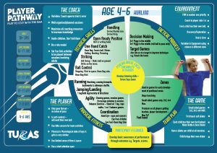
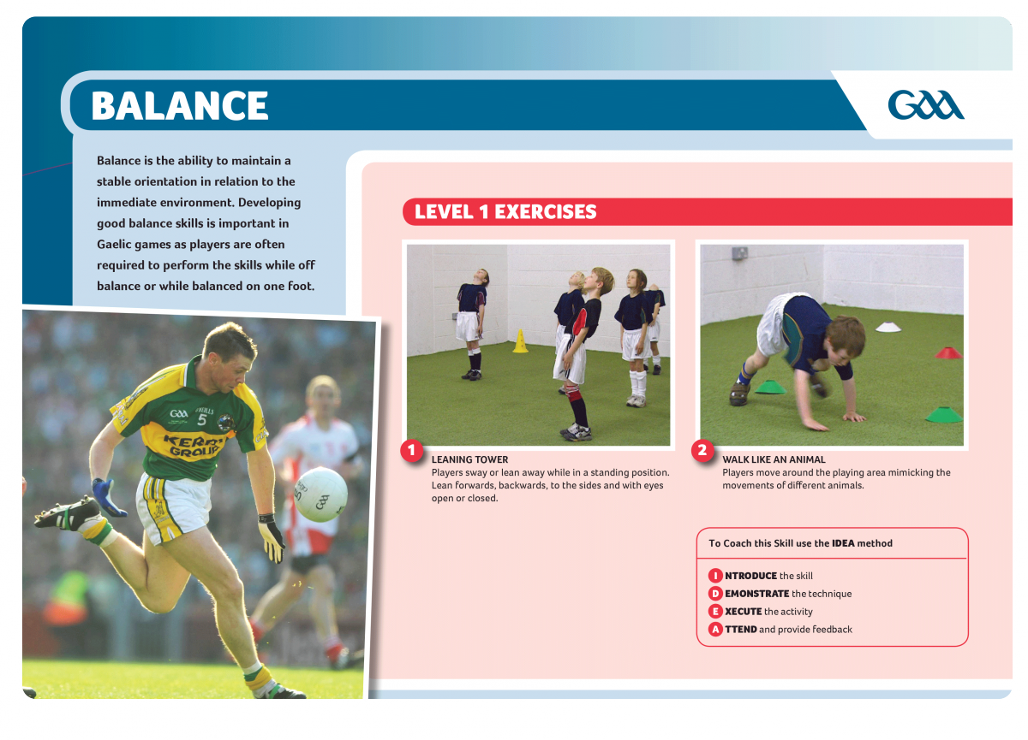
Coaching Resources
http://learning.gaa.ie/planner/
https://leinstergaa.ie/wp-content/uploads/sites/33/2020/05/Hurling-Player-Pathway-4-17.pdf
https://learning.gaa.ie/footballskills
https://learning.gaa.ie/hurlingskills

Slide 10
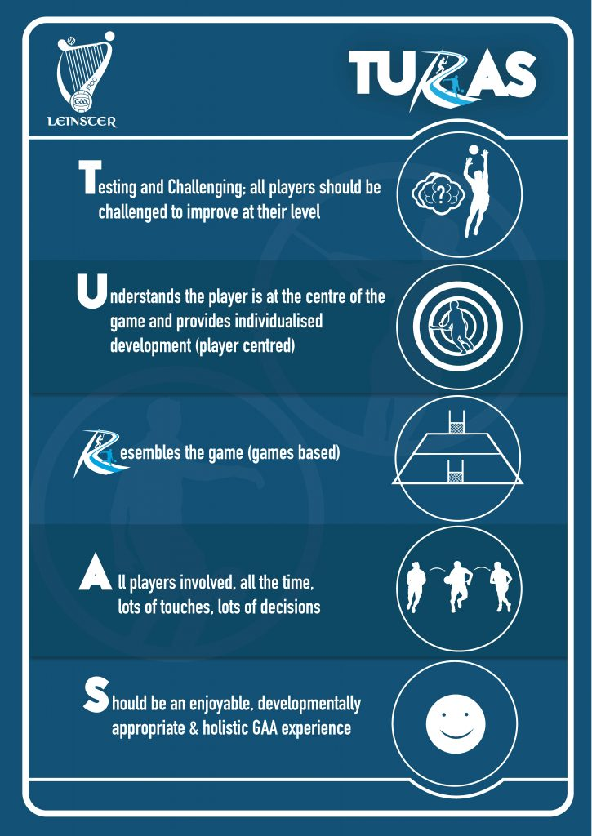
Coaching Resources

Slide 11
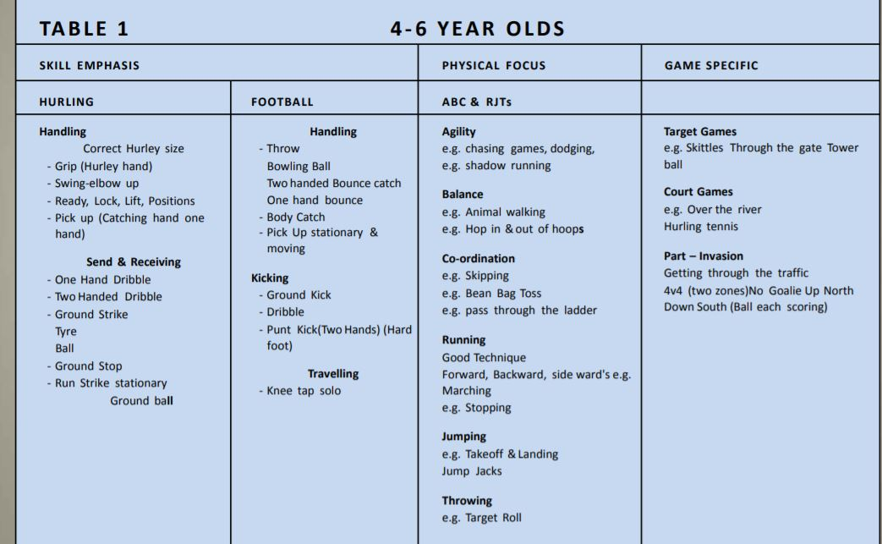
Learning Phase

Slide 12
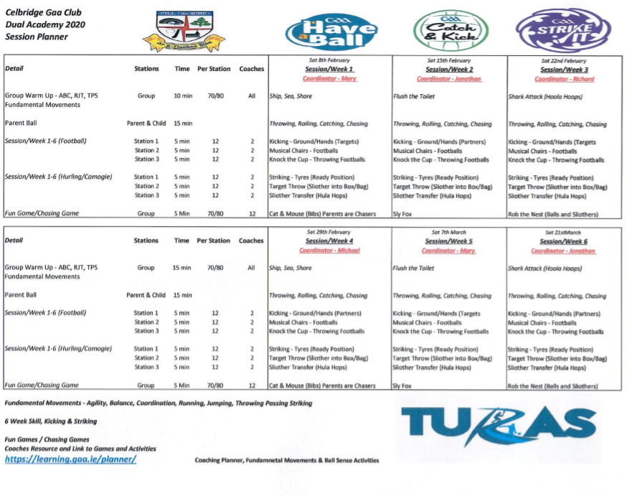
Planning

Slide 13
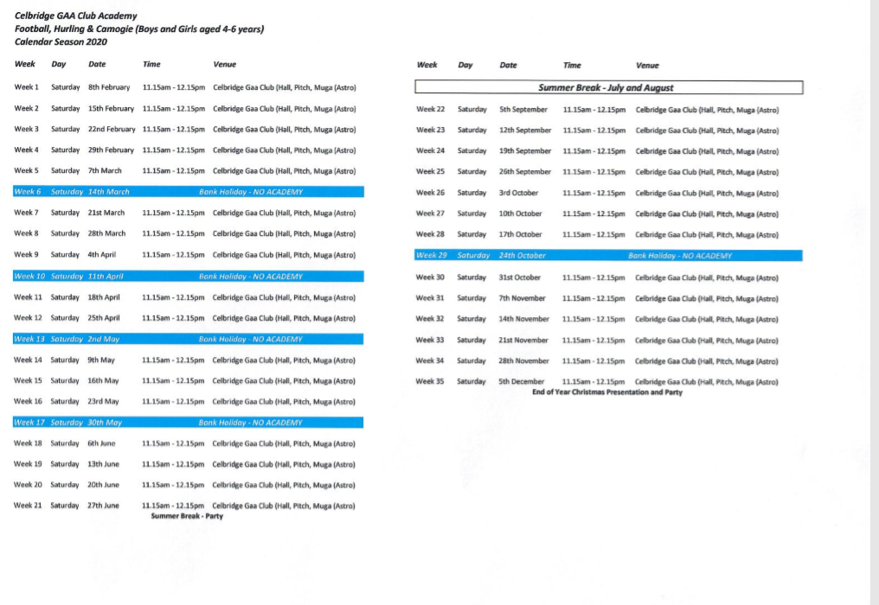
Planning/Annual Calendar

Slide 14
Equipment Checklist
Footballs (1 Ball per child)
Hurls & Helmets (Hurlogs, Indoor hurls)
Hurling Ball (Large Academy Balls)
Cones
Poles
Ladders
Hurdles
Bean Bags/Tennis Balls
Bibs
Tyres
Tackle bags

Slide 15
Nursery Initiatives
Primary Schools Coaching (Jan & Sept 6-week Block, Jnr & Snr Infants)
Dermot Earley Youth Leadership Initiative (TY’s coaching/helping)
Healthy Club (Fruit after each academy session)
Easter, Summer and Halloween Camps (5 Day Camps)
Summer Party (Treats)
Internal Blitzes (6-Year-Old Group, Sept/Oct in preparation for go Games)
Halloween Fancy Dress Coaching
Jersey Day (Senior player to present each child with a club Jersey Nov)
Christmas Party (Selection Box, Medal & Academy Cert, Dec)

Slide 16
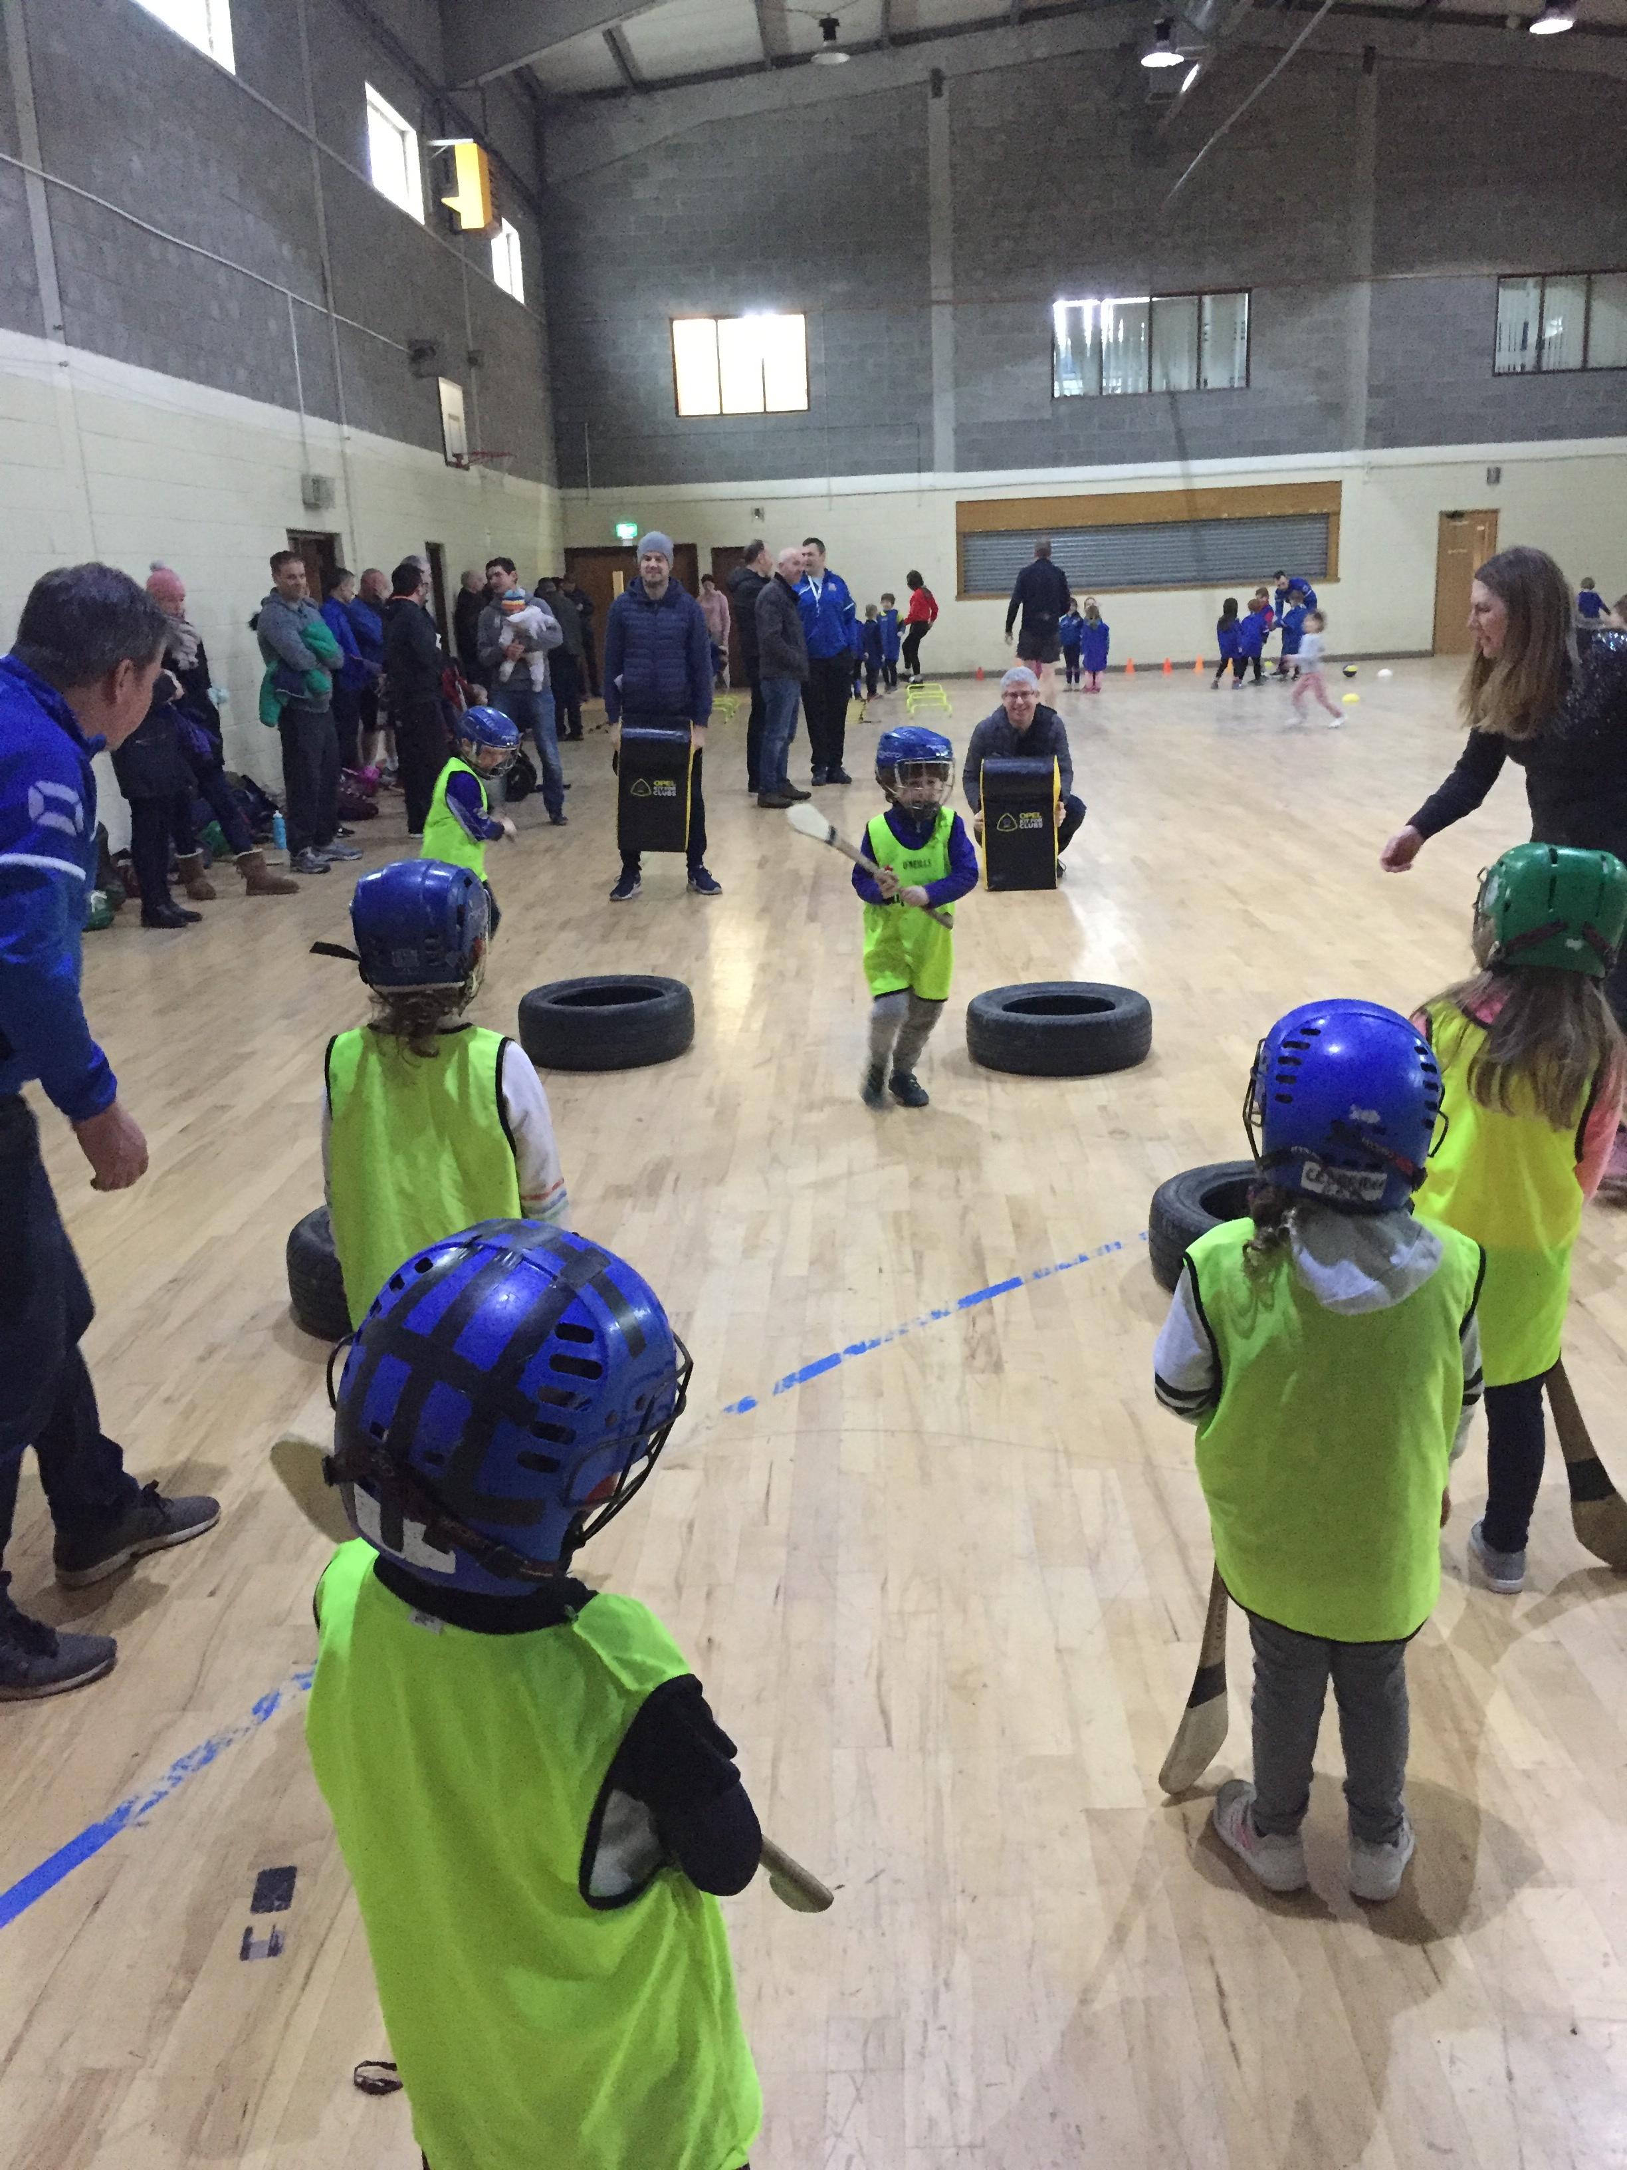
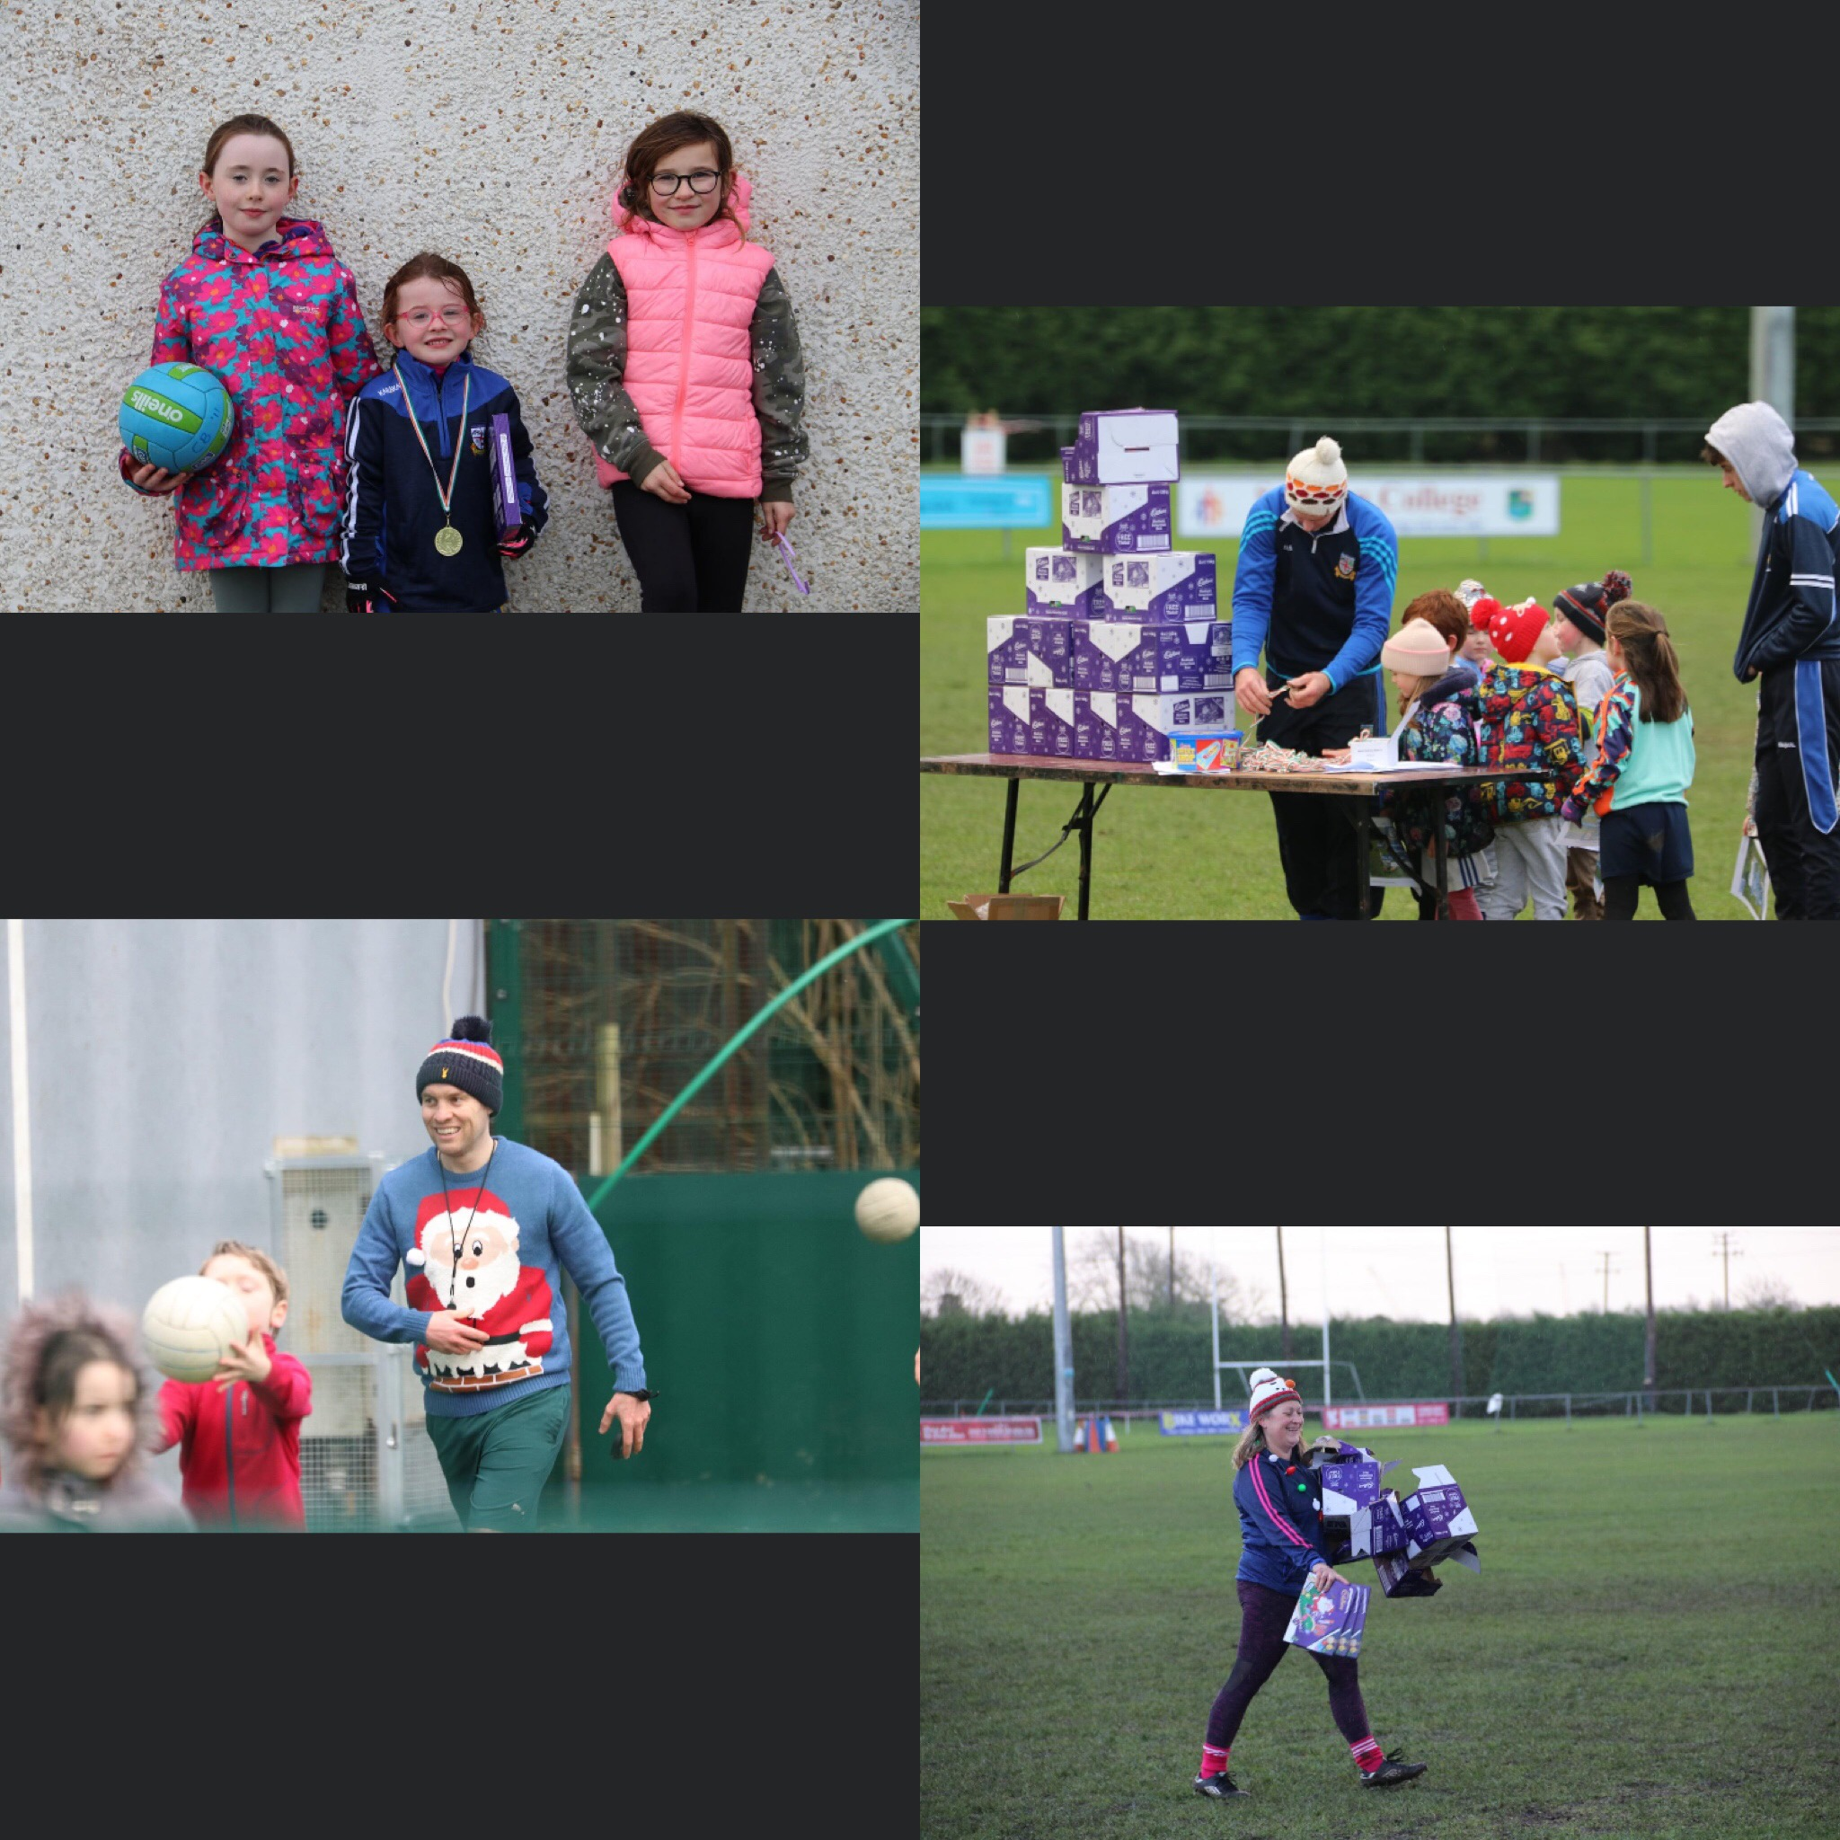
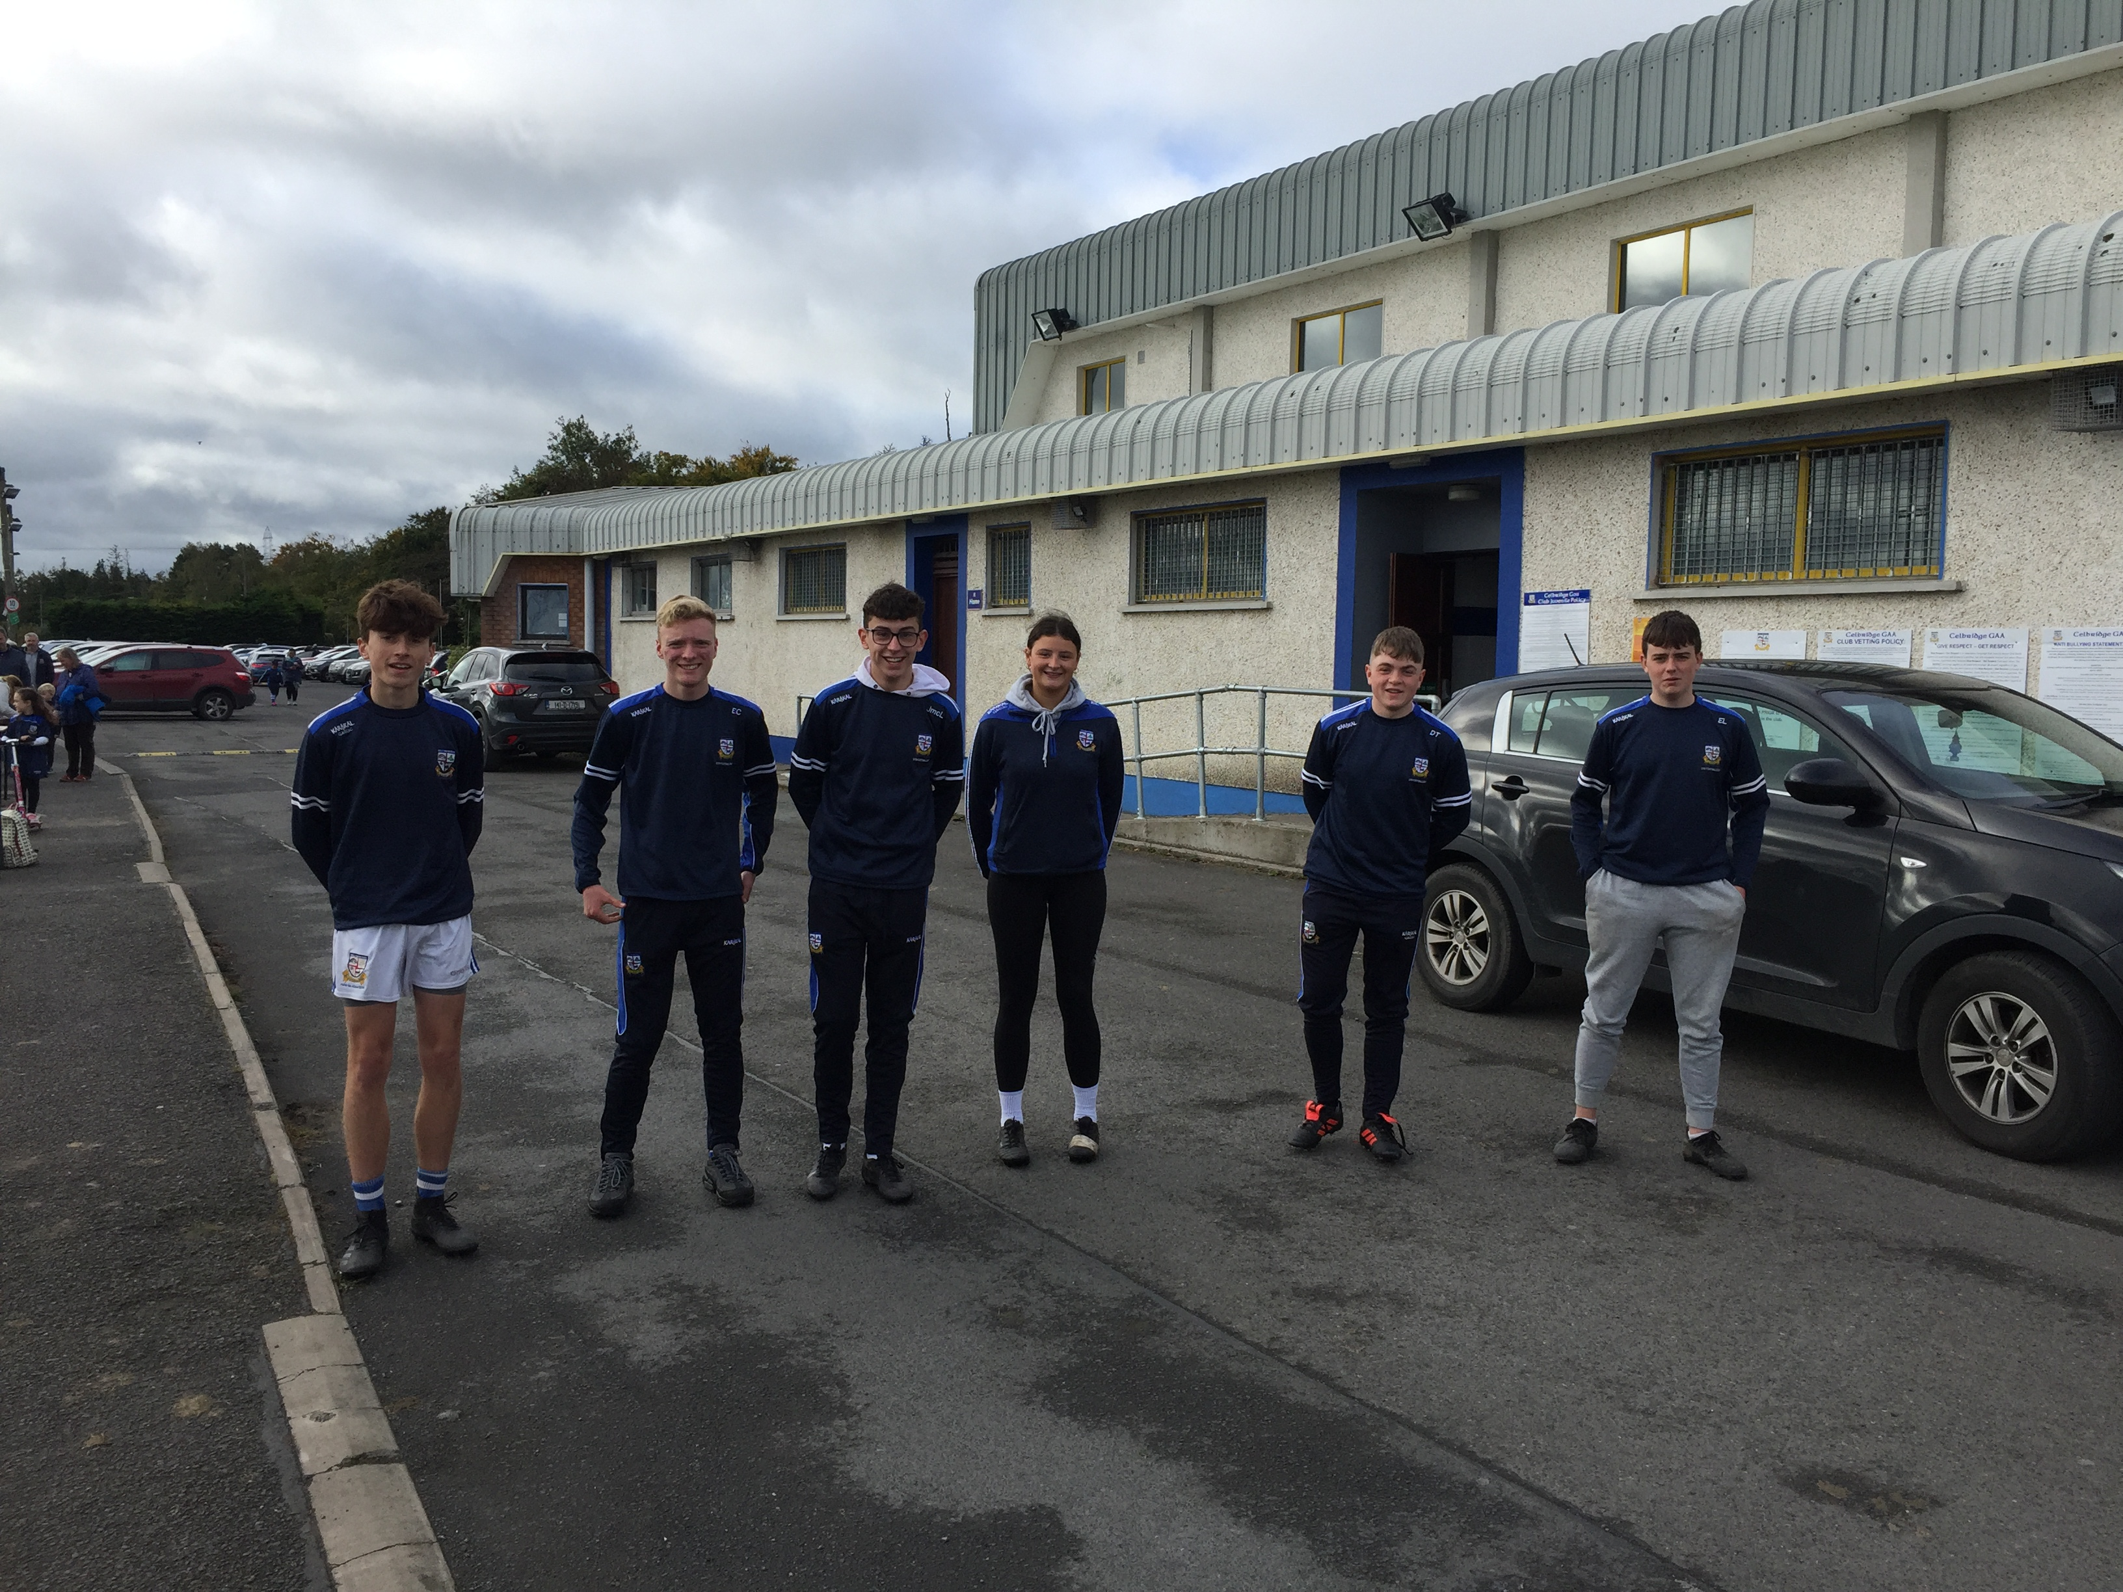
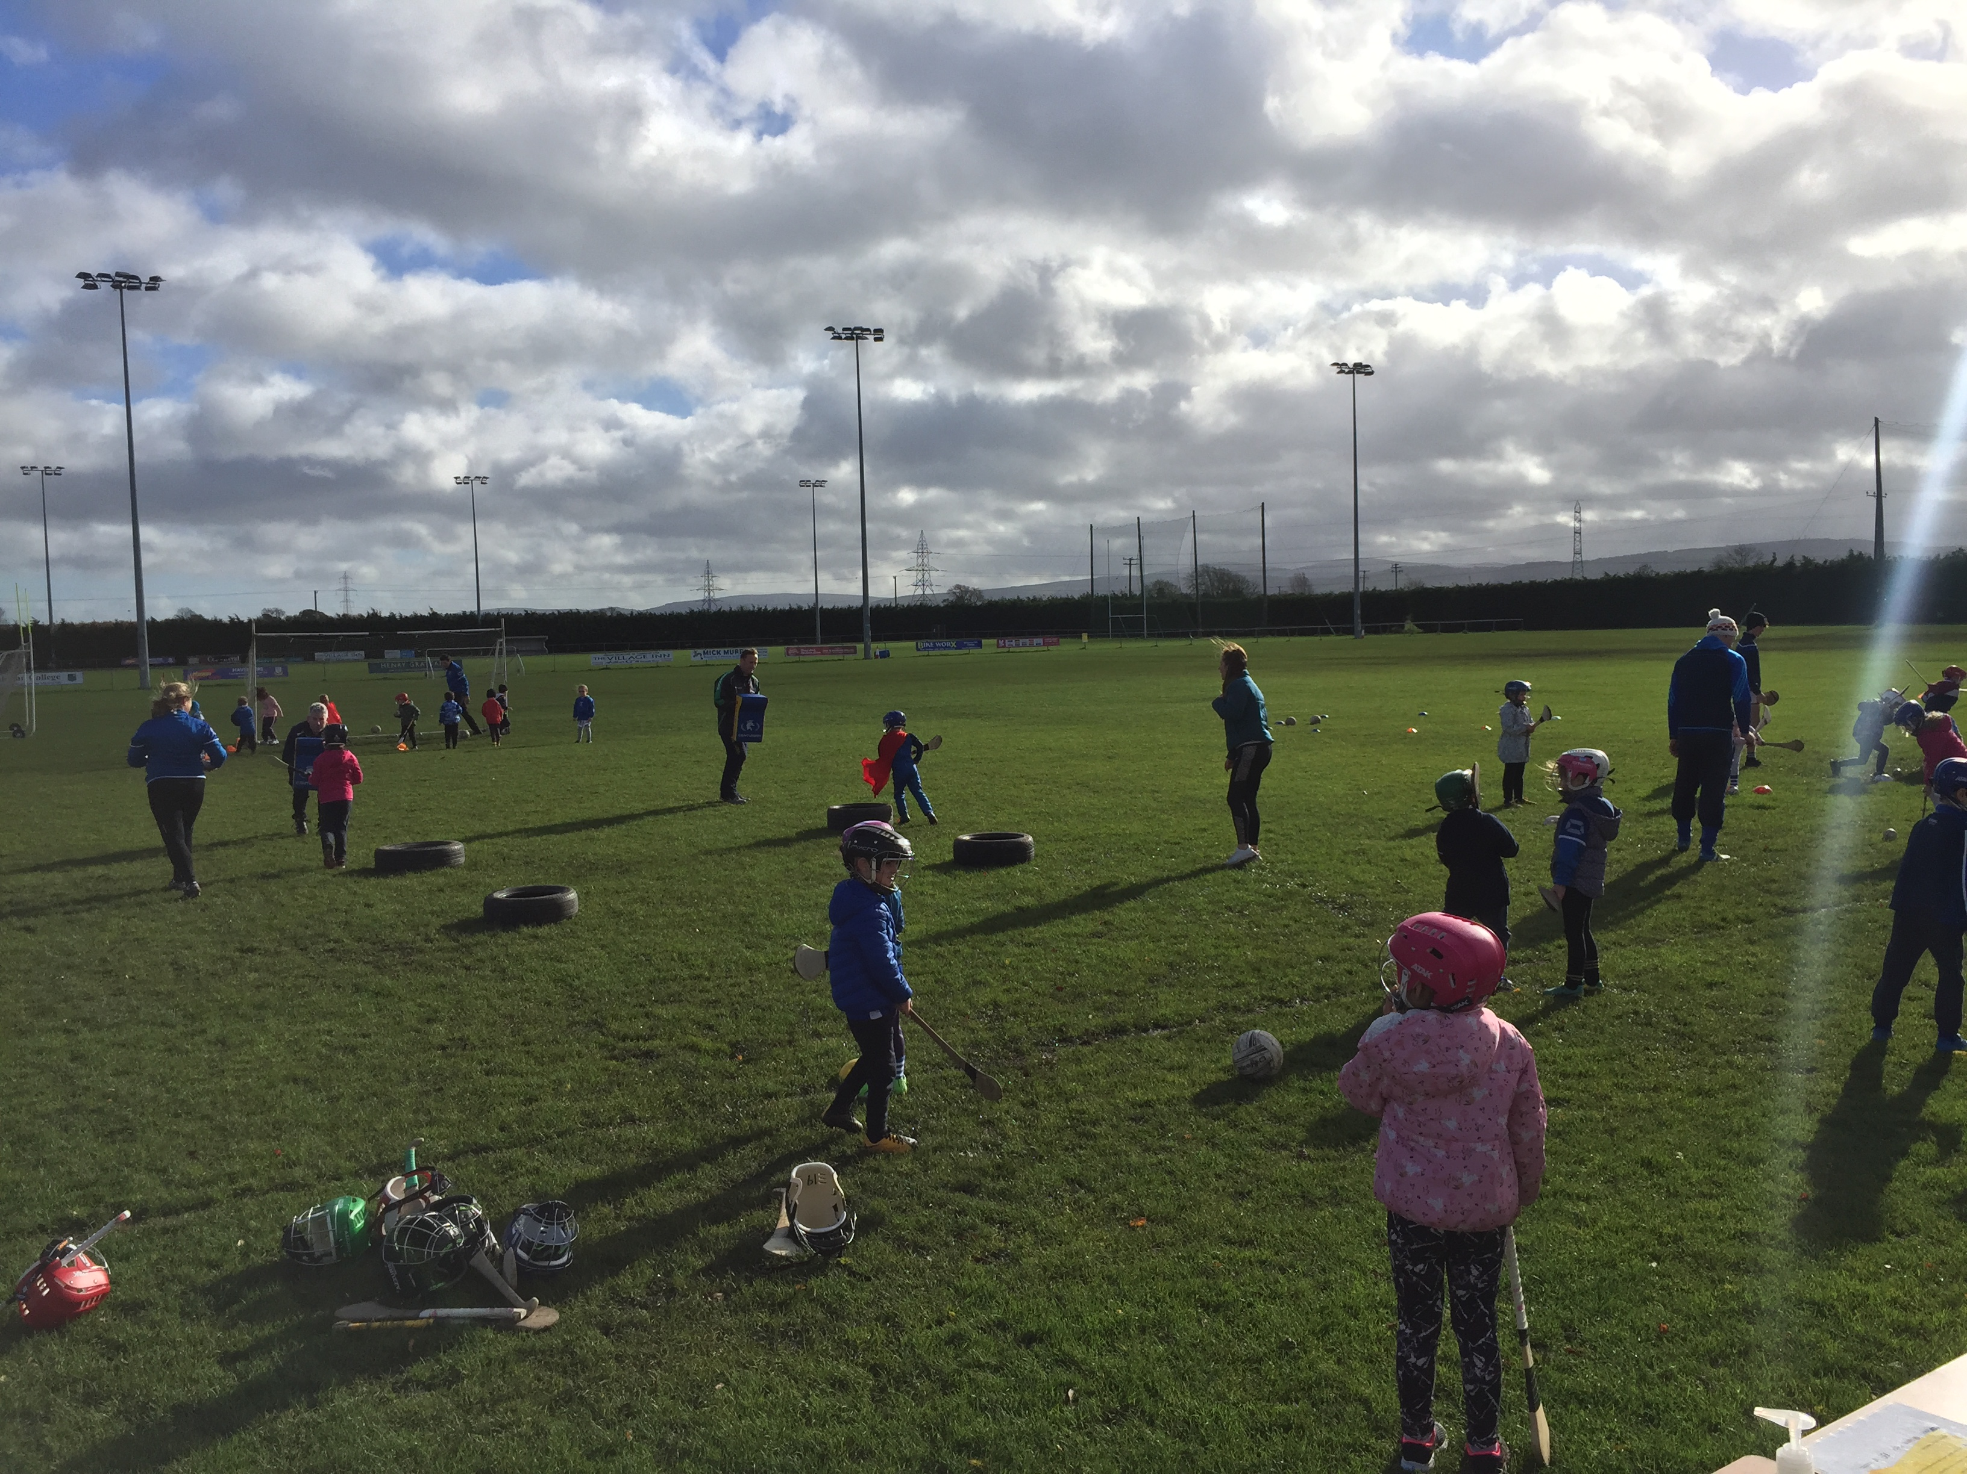
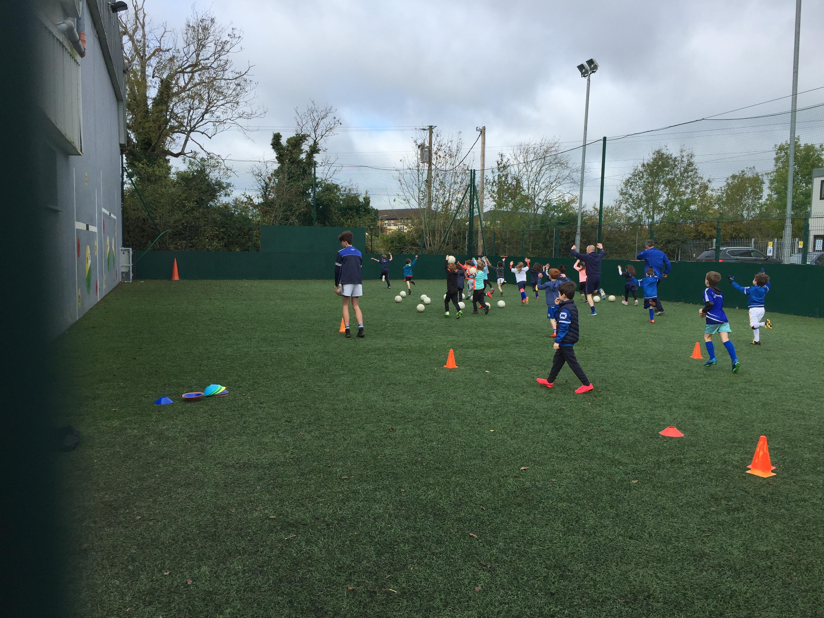

Slide 17
Thank You

